Slide 1
Exception and Error Handling
Abdulhameed Yunusa
Lecturer in Computer Science

Slide 2
Introduction to exceptions
Exceptions are runtime errors that occur during program execution.
Instead of crashing, Python allows you to handle these exceptions gracefully.
Exception handling helps make programs more robust and user-friendly.

Slide 3
Common types of exceptions
ZeroDivisionError: Raised when dividing by zero.
TypeError: Raised when an operation or function is applied to an object of inappropriate type.
IndexError: Raised when trying to access an index that is out of range.
KeyError: Raised when trying to access a dictionary key that doesn’t exist.
ValueError: Raised when a function receives an argument of the correct type but inappropriate value.

Slide 4
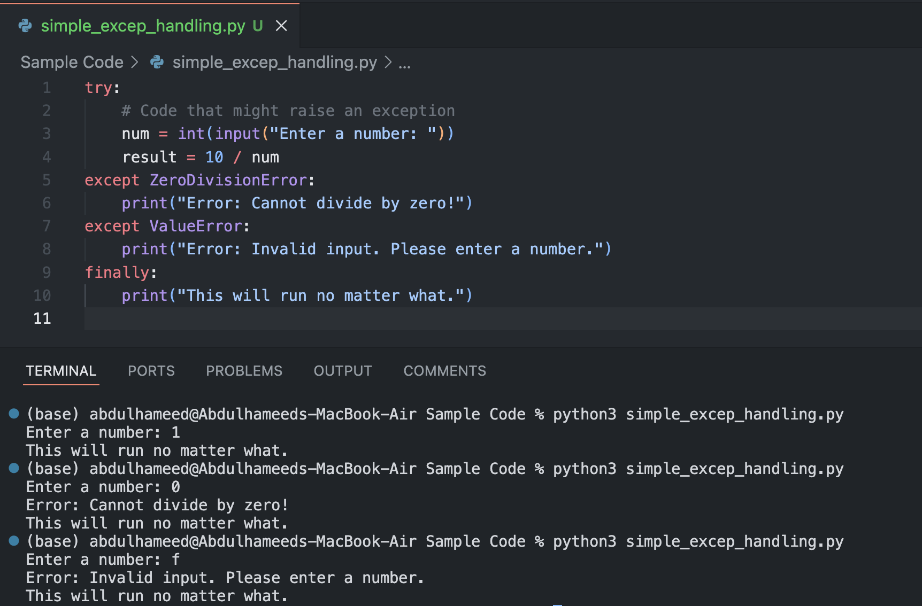
Basic Exception Handling Syntax
Python provides try-except blocks to handle exceptions
Key Concepts:
try block: Code that may raise an exception.
except block: Code that handles the exception.
finally block: Optional block that runs no matter what, useful for cleanup.

Slide 5
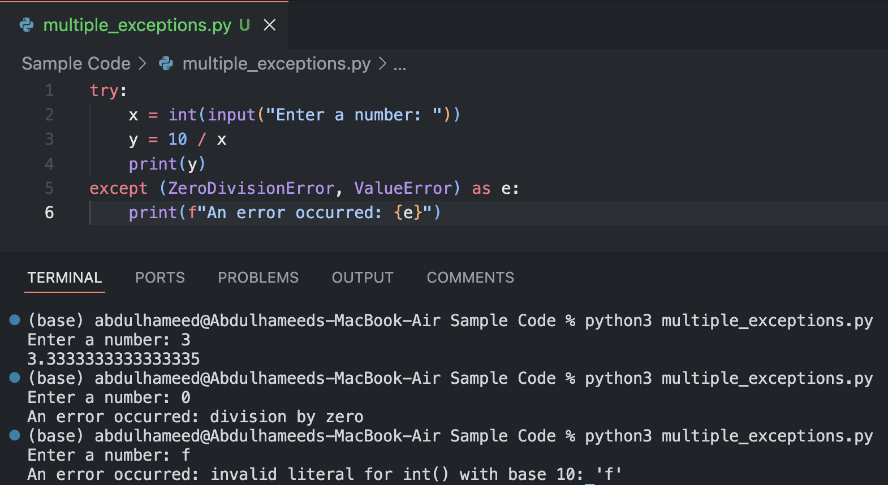
Multiple Exception Handling
You can handle multiple exceptions in a single try-except block.
Key Concepts:
Grouping multiple exceptions into one block using parentheses.
Storing the exception message in a variable using as.

Slide 6
Multiple Exception Handling
You can handle multiple exceptions in a single try-except block.
Key Concepts:
Grouping multiple exceptions into one block using parentheses.
Storing the exception message in a variable using as.

Slide 7
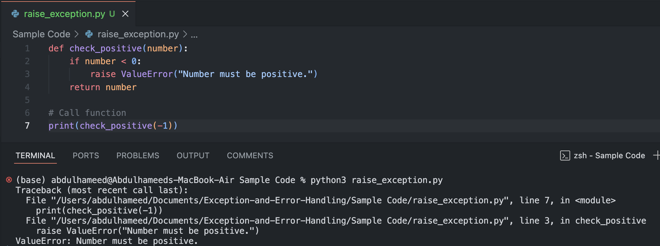
Raising Exceptions
You can manually raise exceptions using raise to indicate an error condition
Key Concepts:
raise allows you to create custom error messages for specific conditions.

Slide 8
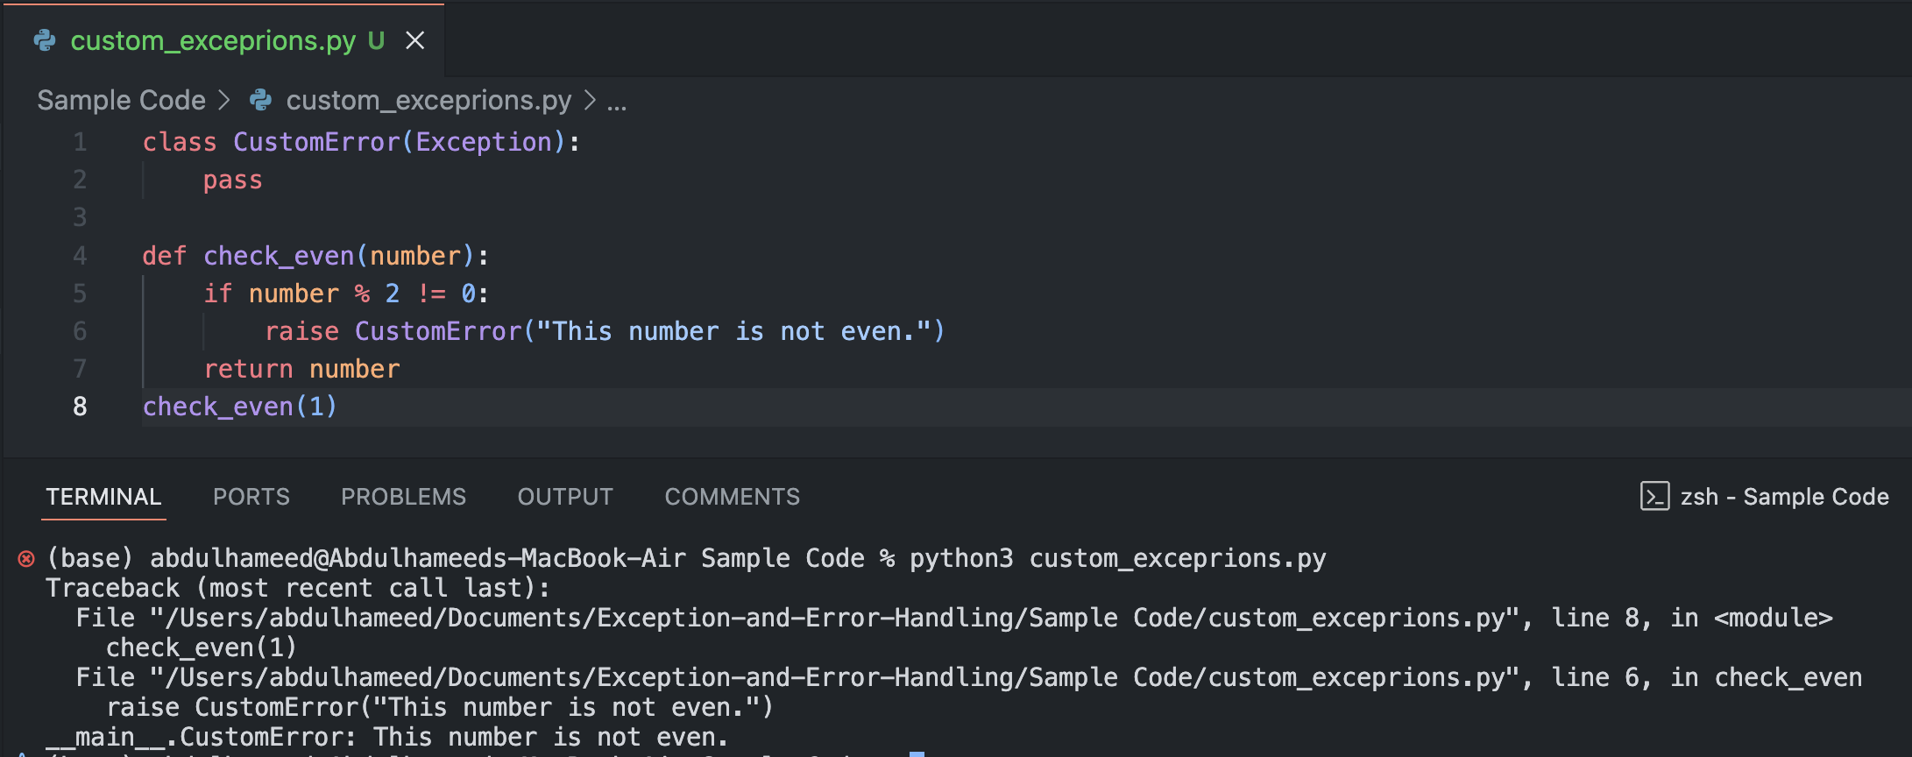
Custom Exceptions
You can define your own exception by creating a new class that inherits from Exception:
Key Concepts:
Creating specialized exceptions to handle specific application requirements.

Slide 9
Custom Exceptions
You can define your own exception by creating a new class that inherits from Exception:
Key Concepts:
Creating specialized exceptions to handle specific application requirements.

Slide 10
Class Activity 1
Task:
Write a program that asks the user for two numbers and divides them. Handle ZeroDivisionError and ValueError appropriately.

Slide 11
Class Activity 2
Task:
Write a function that takes a number as input. Raise a custom exception if the number is negative.

Slide 12
Class Activity 3
Task:
Open a text file, read the contents, and handle the FileNotFoundError if the file does not exist. Always close the file using the finally block.

Slide 13
Best practices
Only catch exceptions you expect to happen.
Use specific exceptions instead of catching all errors (except Exception).
Ensure that exceptions are handled in a way that does not hide underlying problems.
Use finally for important cleanup actions like closing files or releasing resources.

Slide 14
Class Activity 4
Task :
Write a Python script that reads a list of numbers from the user. Raise an exception if the user enters a non-numeric value or a negative number.
Task 2:
Extend the script to write the valid numbers to a file and handle any IOError exceptions.

Slide 15

This Photo by Unknown Author is licensed under CC BY-SA-NC

Slide 16

This Photo by Unknown Author is licensed under CC BY

